Slide 1
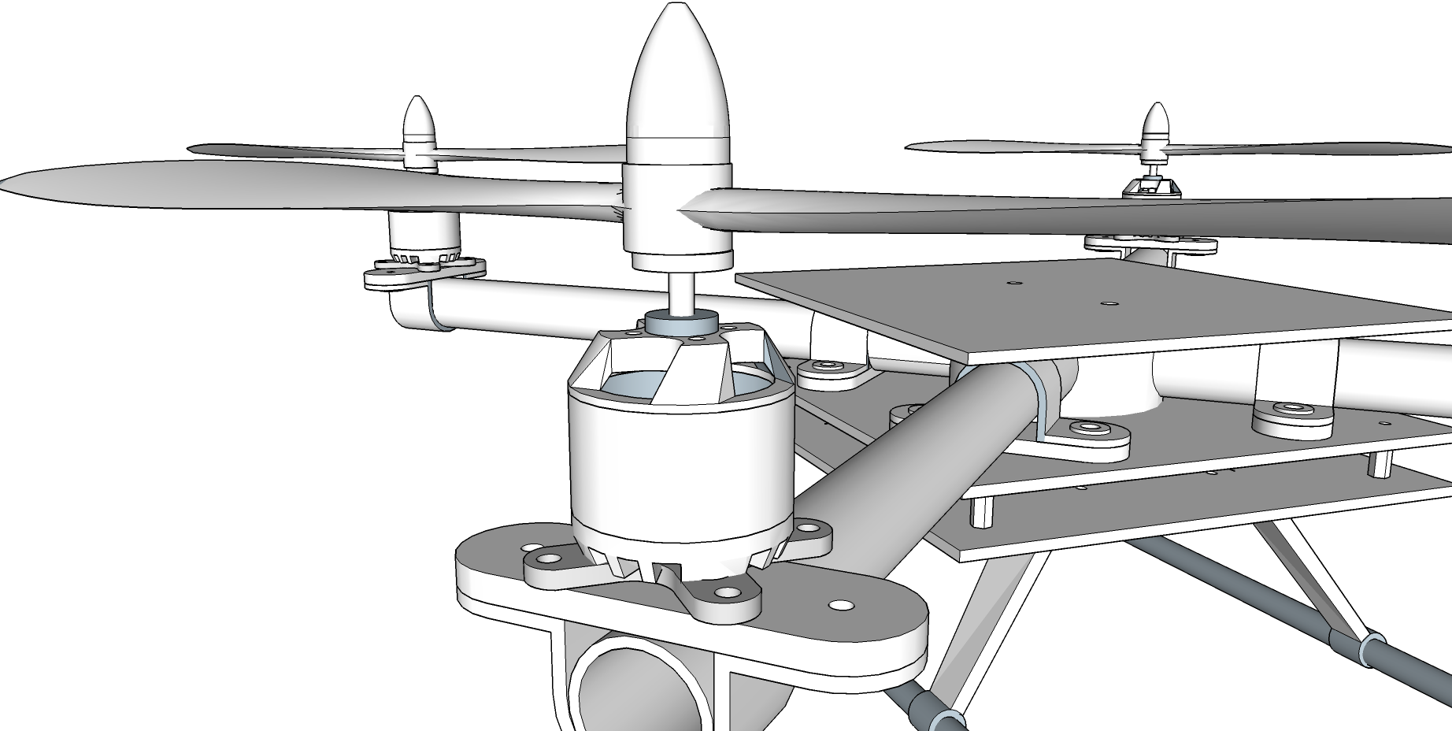
Quadcopter Project
By Kevin Ross

Slide 2
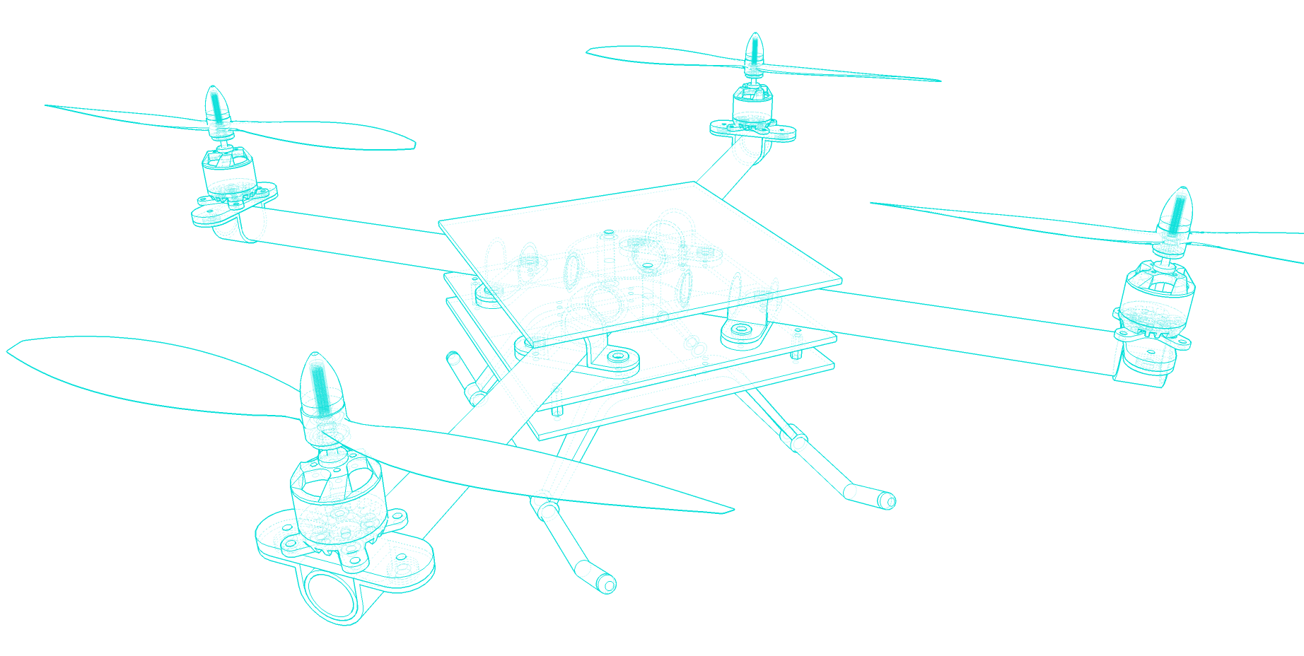
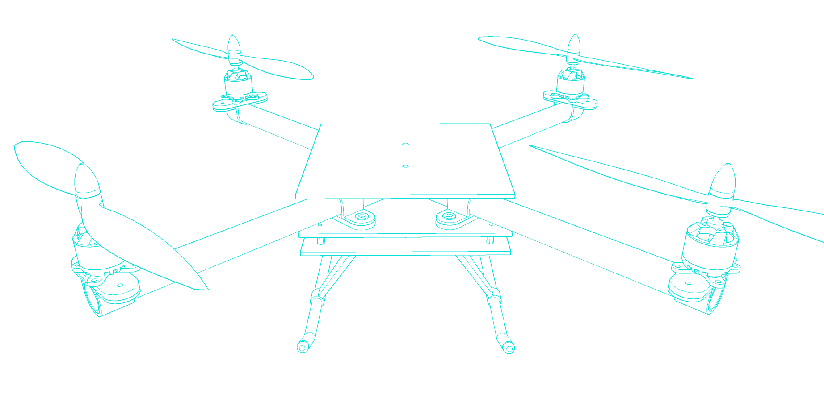
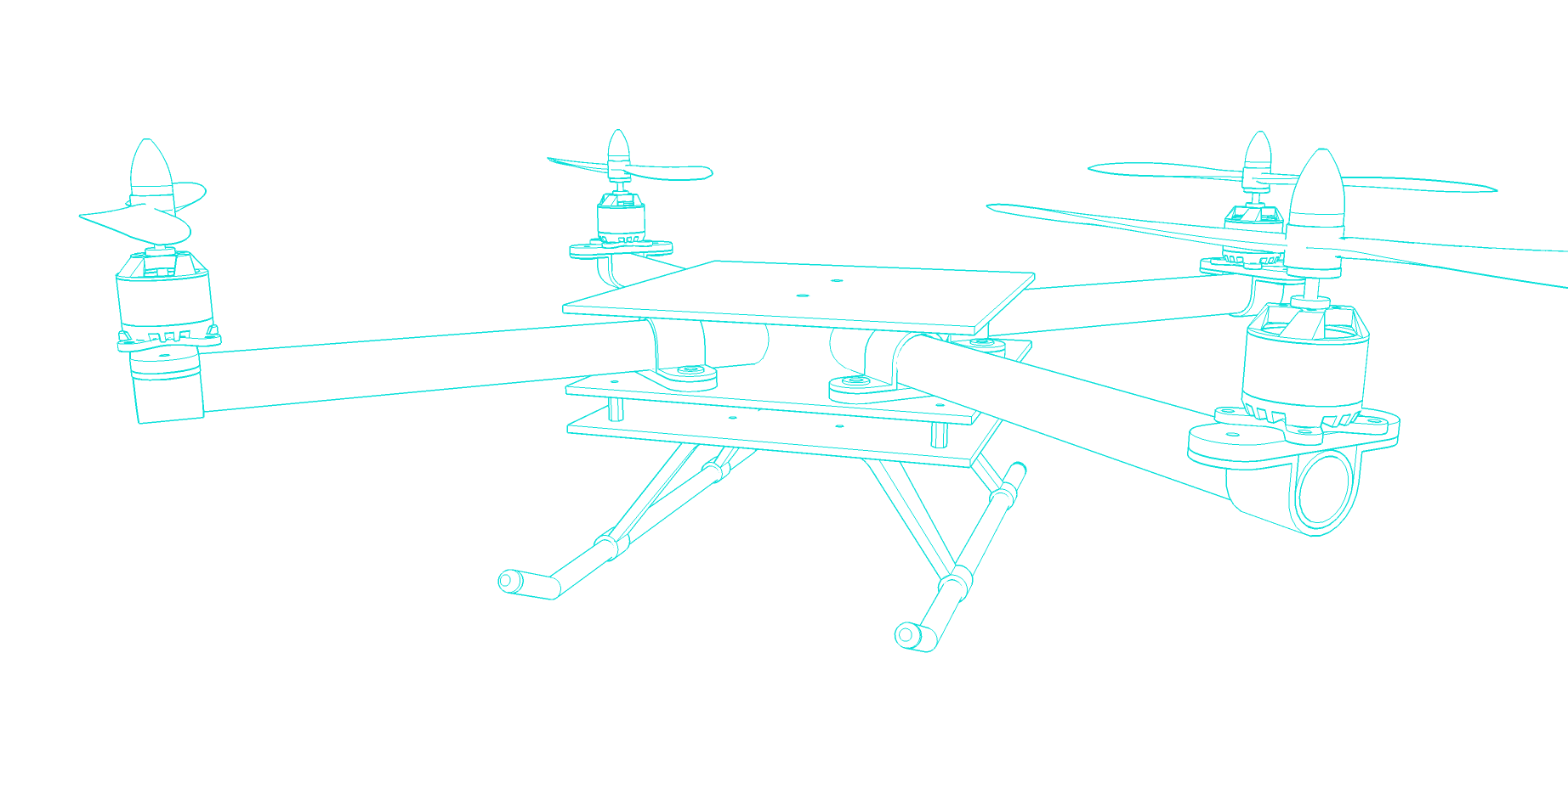


Slide 3
Basic System Overview
Battery
ESC Power Harness
Atmega 328p Microcontroller
Transmitter
Radio Link
2.4GHz
Receiver
ESC 1
Motor 1
IMU
ESC 2
Motor 2
3-Axis Gyro
ESC 3
Motor 3
3-Axis Accelerometer
ESC 4
Motor 4
3-Axis Magnetometer
Demand
PID
Controller
Measured
Output
As a Result of the output there will be a new measured value

Slide 4
Hardware - Enables signals to read
Driver Software - Utilises the hardware and enables low level read/write to and from hardware providing an API.
Library/Func. - Code that interacts with the driver API and performs calculations.
ISR - Routine called when a particular interrupt is fired
Throttle [PWM]
Roll [PWM]
Pitch [PWM]
Yaw [PWM]
Aux [PWM]
50Hz 20ms PWM Frequency Pulse length usually 1ms - 2ms
Atmega 328p Microcontroller
Hardware
Main (1MHz)
Driver Software (API)
Transmitter
Radio Link
2.4GHz
Library/Functions (Tasks)
Receiver
EXTINT
Interrupt Service Routine
Read PWM Driver
Digital
Write
DigitalWrite Driver
X4 Pins
LEDs
PinChange ISR
Radio (100KHz)
ESC 1
Motor 1
IMU
EXTINT
Motor 1 [PWM]
Motor 2 [PWM]
Motor 3 [PWM]
Motor 4 [PWM]
ESC 2
Motor 2
Cyclic Collective Throttle Mixer
Write PWM Driver
TC 0
Gyro [I2C]
Accelerometer [I2C]
Magnetometer [I2C]
100Hz 10ms
PinChange ISR
PID Control
(200Hz)
3-Axis Gyro
TC 2
ESC 3
Motor 3
3-Axis Accelerometer
TWI 0
ESC 4
Motor 4
I2CDriver
Sensors (200Hz)
3-Axis Magnetometer
TC1 Overflow ISR
Angle Calculations will take place on the DMP (Digital Motion Processor)
MPU-6050 (6 Axis)
MPU-9250 (9 Axis)
PID Controller loop will need to run around at 200Hz as that is the fastest the sensor will have new data. Therefor in 5ms need to
Read Sensor & Radio - PID - Write to Motors
Note: PID Will take most time and computation heavy. Need to avoid floating point math if possible.
Main Controller Timed scheduler
TC 1 will be used to clock the main controller, ensuring all tasks are scheduled correctly. ISR will be simple, only incrementing a count
Watchdog
TC1 Driver
TC 1
Watchdog Driver
Watchdog
Debug
USART 0 Driver
USART 0

Slide 5
Main
Events/Interrupts
Void main(){
while(1){
If (Controlcount >= 5ms){
PCINT - THRO
PCINT - RUDD
PCINT - ALIE
PCINT - ELEV
PCINT - AUX
Generated on rising all falling edge every 1ms-2ms (1000us - 2000us)
On Pin change captures tick count.
Calculates the time difference between falling and Rising edge
Updates GV
Control Sequence
Sensor
Radio
Radio
PID
Interrupt generated when data available on the IMU
Generated every 200Hz (5ms) (Could get away with 50Hz)
Can then trigger read in main or just notify there is new data (Note: I2C read must NOT take place in the ISR)
Mixer
Sensor
PCINT - Data Ready/DMP
Motors
ControlCount = 0; //Reset count
}
Overflow interrupt, will overflow every 1us.
Will increment counter, used to clock time the main loop and tasks
Wake the controller
Timer 1
OVF- 1MHz
Else if (DIOcount >= 10ms){
DIO
DIOCount = 0; //Reset count
}
Watchdog
Sleep

Slide 6
Main
#define TASK_A_TIME 2000
#define TASK_B_TIME 1000
Void main(){
while(1){
If (taskACount >= TASK_A_TIME){
TaskA(); // Perform task A
taskACount = 0;
}
Else if (taskBCount >= TASK_B_TIME){
TaskB(); // Perform task B
taskBCount = 0;
}
Else if (watchdogCount >= WATCHDOG_TIME){
resetWD(); // reset Watchdog
watchdogCount = 0;
}
}
}
//Overflow Interrupt called everytime T1 overflows. T1 will overflow every 1us.
Void T1_OVF_ISR(){
taskACount ++;
taskBCount ++;
watchdogCount++;
}
Notes:
Perhaps the main should be a state machine - Read Input, Compute, Output running at 200hz loop rate.

Slide 7
Code modules
Library | Notes
Sensor (Process Variable) | Read sensor values from IMU and store to local variable.
Radio (Set Point) | Read raw value from the Global Variable (published from Radio Interrupts)
PID | Compute the PID
Mixer | Take the outputs from the PID and mix this with the motor values. Account for X or +
Motors (Output) | Write values from mixer to the motors (Speed Controllers take a PWM Signal of 1000-2000us width)
DIO | Output to DIO used for Status LEDs and debug
Watchdog | Feed the watchdog. Feed rate should be defined by how long the state machine takes

Slide 8
Data Ready/DMP
Interrupt generated when data is ready in the registers or in the DMP.
This is a nod to read the data. This occurs @ 100hz (10ms)
Sensors
Notes
Gyroscopes, or gyros, are devices that measure or maintain rotational motion. MEMS (microelectromechanical system) gyros are small, inexpensive sensors that measure angular velocity. The units of angular velocity are measured in degrees per second (°/s) or revolutions per second (RPS).
An accelerometer is an electromechanical device used to measure acceleration forces. Such forces may be static, like the continuous force of gravity or, as is the case with many mobile devices, dynamic to sense movement or vibrations. Acceleration is the measurement of the change in velocity, or speed divided by time. Units dv/dt where V = velocity
Magnetometers are measurement instruments used for two general purposes: to measure the magnetization of a magnetic material like a ferromagnet, or to measure the strength and, in some cases, the direction of the magnetic field at a point in space. Units Tessla or Gauss
PCINT
IMU
INT
I2C Driver
I2C
TWI 0
Sensors
3-Axis Gyro
3-Axis Accelerometer
I2C
3-Axis Magnetometer
I2C
Angle Calculations will take place on the DMP (Digital Motion Processor)
MPU-6050 (6 Axis)
MPU-9250 (9 Axis)
DMP calculates the angle at a rate of 100Hz
I2C Driver
Low level comms across I2C. This enable comms
Utilize the wire library, future may need to write own i2c implementation
Sensors
Utilise the API exposed from the I2C driver to configure and W/R from specific sensor
ConfigGyro
readGyro[x,y,z]
ConfigAcc
readAcc[x,y,z]
ConfigMag
readMag[x,y,z]
ConfigDMP
readDMP[Roll,Pitch,Yaw]

Slide 9
EXTINT
Throttle Demand
Radio
PinChange
Interrupt
Global Variable
[b_radioFlags_GV]
Roll Demand
PinChange
Interrupt
Pitch Demand
Global Variable
[iPilotDemand_GV]]
Yaw Demand
Radio Link
2.4GHz
PinChange
Interrupt
AUX Demand
Transmitter
Gear Demand
Receiver
PinChange
Interrupt
Radio
// check shared update flags to see if any channels have a new signal
if(bUpdateFlagsShared)
{
noInterrupts(); // turn interrupts off quickly while we take local copies of the shared variables
// take a local copy of which channels were updated in case we need to use this in the rest of loop
bUpdateFlags = bUpdateFlagsShared;
if(bUpdateFlags & THROTTLE_FLAG)
{
unThrottleIn = unThrottleInShared;
}
if(bUpdateFlags & STEERING_FLAG)
{
unSteeringIn = unSteeringInShared;
}
if(bUpdateFlags & AUX_FLAG)
{
unAuxIn = unAuxInShared;
}
// clear shared copy of updated flags as we have already taken the updates
// we still have a local copy if we need to use it in bUpdateFlags
bUpdateFlagsShared = 0;
interrupts(); // we have local copies of the inputs, so now we can turn interrupts back on
// as soon as interrupts are back on, we can no longer use the shared copies, the interrupt
// service routines own these and could update them at any time. During the update, the
// shared copies may contain junk. Luckily we have our local copies to work with :-)
}
PinChange
Interrupt
Read PWM Driver
Configure the Pin Change Interrupt
configChangeInterrupt(PIN, CHANGE Type)
Enable
Disable
PinChange ISR (Generated Every 1KHz)
void calcThrottlePulse()
{
if(PCintPort::pinState)
{
unThrottleInStart = TCNT1;
}
else
{
unThrottleInShared = (TCNT1 - unThrottleInStart)>>1;
bUpdateFlagsShared |= THROTTLE_FLAG;
}
}

Slide 10
Radio
Channel | Mapped (Min,Max)
Throttle | 1000,2000
Roll | -1, 1
Pitch | -1, 1
Yaw | -1, 1
AUX
Gear
F Mode Gear
TH CUT
Flap
GYRO
+tve
+tve
Throttle
Elevator
(Pitch)
Note:
Flap Gyro = AUX1
F-Mode Gear = GEAR
TH Cut = TH_CUT
-tve
+tve
+tve
-tve
Rudder (Yaw)
Ailerons
(Roll)

Slide 11
20ms (50Hz)
PWM Signal RX from Transmitter
Duty Cycle = 50%
1ms (1KHz)
PWM Signal RX from Transmitter
Duty Cycle = 5%,1000us
2ms (500Hz)
PWM Signal RX from Transmitter
Duty Cycle = 10%, 2000us
5-10% (1000us - 2000us) duty cycle gives the band of the received PWM signal. This could be 0-100% throttle or full left and right, forward or backward, depending on what input.

Slide 12
PID - Generic Closed Loop Control
Reference
Measured Error
Controller
System Input
System
System Output
+
-
Measured Output
Sensors
Quadcopter Closed Loop Control (Simple)
Pilot Demand
Angle/Rate
Measured Error
Angle/Rate
Controller
(PID)
Motor Demand
System
(Quadcopter)
Angle or Rate change
+
-
Roll, Pitch and Yaw Angle/rate
Sensors
(IMU)

Slide 13
Will need a Control loop for Roll, Pitch and Yaw.
For Both Position (angle) and Rate in total 6 PID Loops
Notes: Proportional - Integral - Derivative
Proportional depends on the present error
Integral depended on the accumulation of past errors
Differential is a prediction of future errors (Affected by noise/vibration)
Where: e = Setpoint - Input
Kp * e(t)
Pilot Demand
Angle/Rate
Measured Error
Angle/Rate
Motor Demand
Error
e(t)
Ki * ∫ e(t) dt
System
(Quadcopter)
Angle or Rate change
+
∑
-
Kd * d/dt * e(t)
Roll, Pitch and Yaw Angle/rate
Sensors
(IMU)

Slide 14
Sudo Code for basic PID
LINK
Problems with this
Sample Time – The PID algorithm functions best if it is evaluated at a regular interval. If the algorithm is aware of this interval, we can also simplify some of the internal math.
Derivative Kick – Not the biggest deal, but easy to get rid of, so we’re going to do just that.
On-The-Fly Tuning Changes – A good PID algorithm is one where tuning parameters can be changed without jolting the internal workings.
Reset Windup Mitigation –We’ll go into what Reset Windup is, and implement a solution with side benefits
On/Off (Auto/Manual) – In most applications, there is a desire to sometimes turn off the PID controller and adjust the output by hand, without the controller interfering
Initialization – When the controller first turns on, we want a “bumpless transfer.” That is, we don’t want the output to suddenly jerk to some new value
Controller Direction – This last one isn’t a change in the name of robustness per se. it’s designed to ensure that the user enters tuning parameters with the correct sign.
Float Input, Output, Setpoint
Unsigned long presTime, prevTime
float Kp, Ki, Kd
Void computePID(){
//Get Dt
presTime = /*Get tick count*/
Dt = presTime - PrevTime;
//Proportional
error = Setpoint - Input;
//Integral
errSum = errSum + (error * Dt);
//Derivative
dErr = (error - prevError)/dt;
//Compute PID
Output = (Kp * error) + (ki * errSum) + (Kd * dErr);
//Remember for next iteration
prevError = Error;
prevTime = presTime;
}
Void tunePID(float Kp, float Ki, float Kd){
Kp = Kp;
Ki = Ki;
Kd = Kd;
}

Slide 15
Proportional Gain coefficient – you quadcopter can fly relatively stable without other parameters but this one. This coefficient determines which is more important, human control or the values measured by the gyroscopes. The higher the coefficient, the higher the quadcopter seems more sensitive and reactive to angular change. If it is too low, the quadcopter will appear sluggish and will be harder to keep steady. You might find the multicopter starts to oscillate with a high frequency when P gain is too high.
Integral Gain coefficient – this coefficient can increase the precision of the angular position. For example when the quadcopter is disturbed and its angle changes 20 degrees , in theory it remembers how much the angle has changed and will return 20 degrees. In practice if you make your quadcopter go forward and the force it to stop, the quadcopter will continue for some time to counteract the action. Without this term, the opposition does not last as long. This term is especially useful with irregular wind, and ground effect (turbulence from motors). However, when the I value gets too high your quadcopter might begin to have slow reaction and a decrease effect of the Proportional gain as consequence, it will also start to oscillate like having high P gain, but with a lower frequency.
Derivative Gain coefficient – this coefficient allows the quadcopter to reach more quickly the desired attitude. Some people call it the accelerator parameter because it amplifies the user input. It also decrease control action fast when the error is decreasing fast. In practice it will increase the reaction speed and in certain cases an increase the effect of the P gain.
Aerobatic flight:
Requires a slightly higher P
Requires a slightly lower I
Increase D
Gentle smooth flight:
requires a slightly lower lower P
Requires a slightly higher I
Decrease D

Slide 16
Quad Can fly on just Gyro Rate and this mode is often known as “Acro” or “Rate Controller”. This is a good starting point. The pilot demand is then therefore a desired rate. When the stick is central it stops the rate of rotation. The quadcopter will not return to level.
Using both angle and rate is known as stabilisation mode and is the most stable for flight and easiest mode to fly in.
Rotational Rate from Gyro (°/sec)
Acro Mode
Rate
PID
Desired Rotational Rate (°/sec)
Motor adjust
Rotational Rate from Gyro (°/sec)
Stability Mode
Actual Angle from Sensor (°)
Angle
PID
Rate
PID
Desired Angle from Pilot (°)
Desired Rotational Rate (°/sec)
Motor adjust

Slide 17
Roll PID
Rotational Roll Rate from Gyro (°/sec)
Roll Angle from Sensor (°)
Angle
PID
Desired Rotational Rate (°/sec)
Rate
PID
Motor Output
Roll Angle from Pilot (°)
Pitch PID
Rotational Pitch Rate from Gyro (°/sec)
Cyclic Collective Throttle Mixer
Pitch Angle from Sensor (°)
Angle
PID
Desired Rotational Rate (°/sec)
Rate
PID
Motor Output
Pitch Angle from Pilot (°)
YawPID
Rotational Pitch Rate from Gyro (°/sec)
Pitch Angle from Sensor (°)
Angle
PID
Desired Rotational Rate (°/sec)
Rate
PID
Motor Output
Pitch Angle from Pilot (°)

Slide 18
Motors
Mode (“+” or “X”)
Write PWM Driver
Uses TC0 and TC2 which are both 8 bit counters. In Waveform Generation mode to generate 4 PWM outputs
configMotorsPWM()
writeMotorsPWM(power%)
Roll PID Output
Motor 1 Value
Cyclic Collective Throttle Mixer
Motor 2 Value
Pitch PID Output
TC 0
Motor 3 Value
TC 2
Yaw PID Output
Motor 4 Value
Cyclic Collective Throttle Mixer (CCTM)
Takes the output from the PID and governs how much power to provide or take away from the motors.
Also takes into account the mode “X” or “+”
Needs to have a running knowledge of the current motor speed to know what to change to
Needs to mix with the throttle value
configCCTM(Mode)
readRollPIDOutput()
readPitchPIDOutput()
readYawPIDOutput()
writeMotor(int motorID, int value)
https://beaglequad.wordpress.com/2015/10/03/the-basic-physics-of-the-quad-copter/

Slide 19
Plus (+) Configuration
Cross (X) Configuration
CW
CCW
CW
M1
M3
M1
CCW
M3
M4
CCW
M2
M4
Pitch
M2
Pitch
CW
CCW
Roll
Roll
Roll Left
Throttle - i = M2
Throttle - i = M3
Throttle + i = M1
Throttle + i = M4
Roll Right
Throttle + i = M3
Throttle + i = M2
Throttle - i = M4
Throttle - i = M1
Where i = Control Value from PID
Yaw CW
Throttle + k = M1
Throttle + k = M2
Throttle - k = M3
Throttle - k = M4
Yaw CCW
Throttle - k = M1
Throttle - k = M2
Throttle + j = M3
Throttle + j = M4
Where k = Control Value from PID
CW
Pitch Forward
Throttle - j = M1
Throttle - j = M3
Throttle + j = M2
Throttle + j = M4
Pitch Back
Throttle + j = M1
Throttle + j = M3
Throttle - j = M2
Throttle - j = M4
Where j = Control Value from PID
Roll Left
Throttle - i = M3
Throttle + i = M4
Roll Right
Throttle + i = M3
Throttle - i = M4
Where i = Control Value from PID
Pitch Forward
Throttle - j = M1
Throttle + j = M2
Pitch Back
Throttle + j = M1
Throttle - j = M2
Where j = Control Value from PID
Yaw CW
Throttle + k = M1
Throttle + k = M2
Yaw CCW
Throttle + j = M3
Throttle + j = M4
Where k = Control Value from PID

Slide 20
Watchdog
Optiboot bootloader
the official ATmega328 bootloader (optiboot) deactivates the watchdog on reset.
The official MEGA bootloader does not.
If WD not deactivated on reset it will trip and be stuck in an infinite reboot loop. Therefore need to activate the watchdog as part of the initialization of the code on boot.
Link: https://tushev.org/articles/arduino/5/arduino-and-watchdog-timer
Watchdog
The bootloader is the little program that runs when you turn the Arduino on, or press the reset button. Its main function is to wait for the Arduino software on your computer to send it a new program for the Arduino, which it then writes to the memory on the Arduino.
InitWD
resetWD

Slide 21
Bootloader
The bootloader is a small program (HEX file , 0.5Kbyte)that allows you to upload sketches to the flash memory directly from Arduino IDE. The HEX file always runs before the main program and that's why it is needed.
Whithout the bootloader :
-The microcontroller still CAN BE PROGRAMMED!(yes, it is possible), but you would need a dedicated AVR programmer to do that. And it is not cheap!
- It can not be programmed through the Arduino IDE.
Supported bootloaders of this method:
Atmega328 Optiboot (for Uno etc. at 16 MHz) (512 bytes)
The code for the following bootloaders is incorporated in the sketch, and will be downloaded depending on which signature is detected.
So we have everything we need.
Link: https://www.instructables.com/id/Atmega328P-PU-Bootloader-Optiboot-Burning-Guide/

Slide 22
Hardware

Slide 23
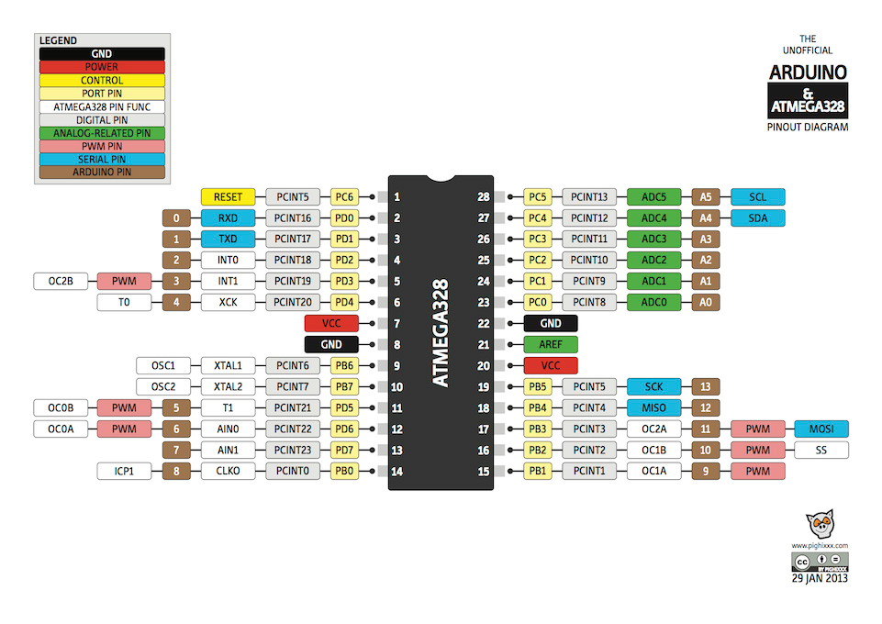

Slide 24
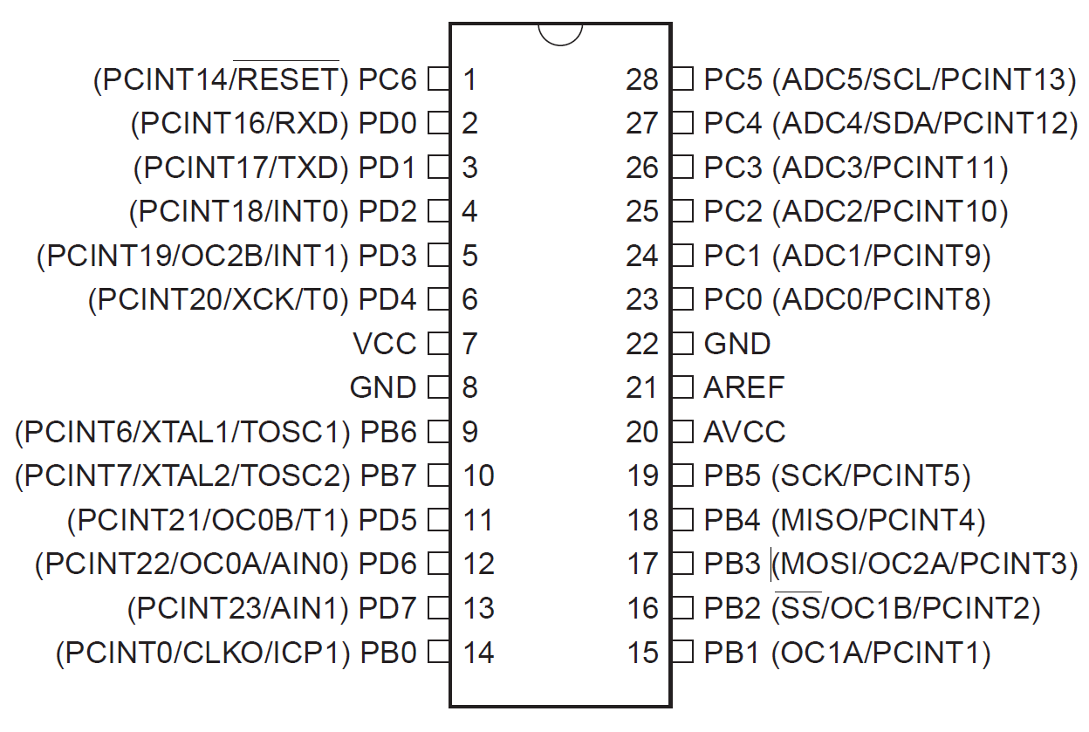

Slide 25
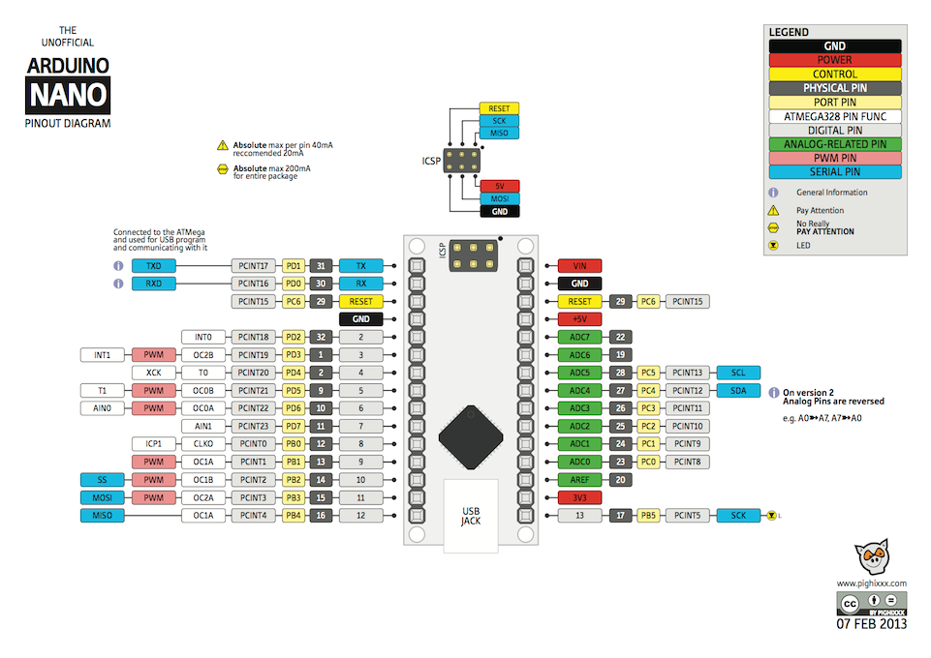

Slide 26
Alias | Description | Physical Pin(Atmega) | Port Pin | Name | Arduino Nano Pin | Direction
SDA | Communication to IMU - I2C | 27 | PC4 | SDA | A4 (SDA) | X
SCL | Communication to IMU - I2C | 28 | PC5 | SCL | A5 (SCL) | X
IMU INT | Read Signal - Pin Change interrupt |  |  |  | D12 | INPUT
THRO | Read PWM Signal - Pin Change interrupt | 32 | PD2 | PCINT18 | 2 | INPUT
ALIE | Read PWM Signal - Pin Change interrupt | 2 | PD4 | PCINT20 | 4 | INPUT
ELEV | Read PWM Signal - Pin Change interrupt | 11 | PD7 | PCINT23 | 7 | INPUT
RUDD | Read PWM Signal - Pin Change interrupt | 12 | PB0 | PCINT0 | 8 | INPUT
GEAR | Read PWM Signal - Pin Change interrupt | 13 | PB1 | PCINT1 | 9 | INPUT
AUX | Read PWM Signal - Pin Change interrupt | 14 | PB2 | PCINT2 | 10 | INPUT
M1 | Generate PWM Signal - Timer/Counter Output Compare | 10 |  |  | 3 | OUTPUT
M2 | Generate PWM Signal - Timer/Counter Output Compare | 9 | PD5 | OC0B | 5 | OUTPUT
M3 | Generate PWM Signal - Timer/Counter Output Compare | 15 |  |  | 6 | OUTPUT
M4 | Generate PWM Signal - Timer/Counter Output Compare | 1 |  |  | 11 | OUTPUT
TXD | Serial comms | 31 | PD1 | TXD | TX | X
RXD | Serial Comms | 30 | PD0 | RXD | RX | X
LED | LED Pin | 17 | PB5 | LED | 13 | OUTPUT
GPIO1 | General IO - LEDs etc | 24 | PC1 | A1 | A1 | OUTPUT
GPIO2 | General IO - LEDs etc | 25 | PC2 | A2 | A2 | OUTPUT
GPIO0 | General IO - LEDs etc | 23 | PC0 | A0 | A0 | OUTPUT
GPIO3 |  |  |  |  | AI3 | Input/Output

Slide 27
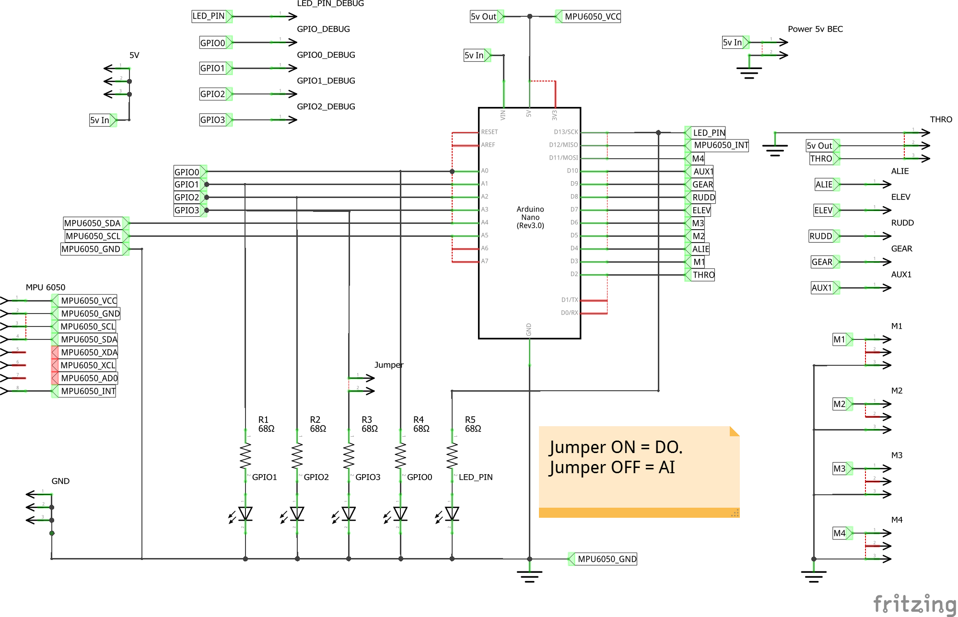

Slide 28
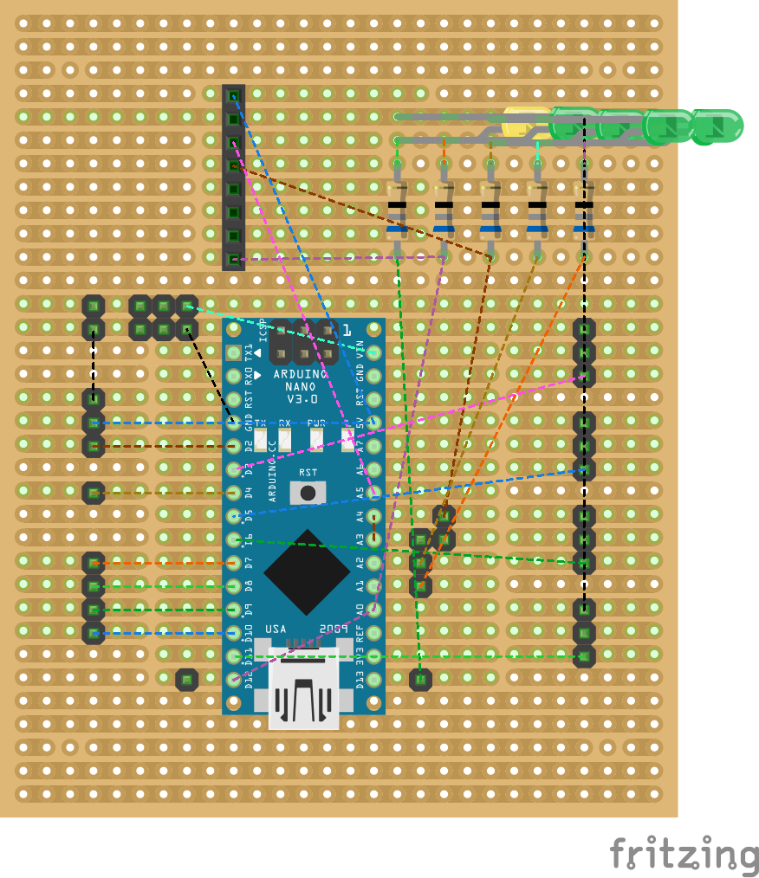

Slide 29
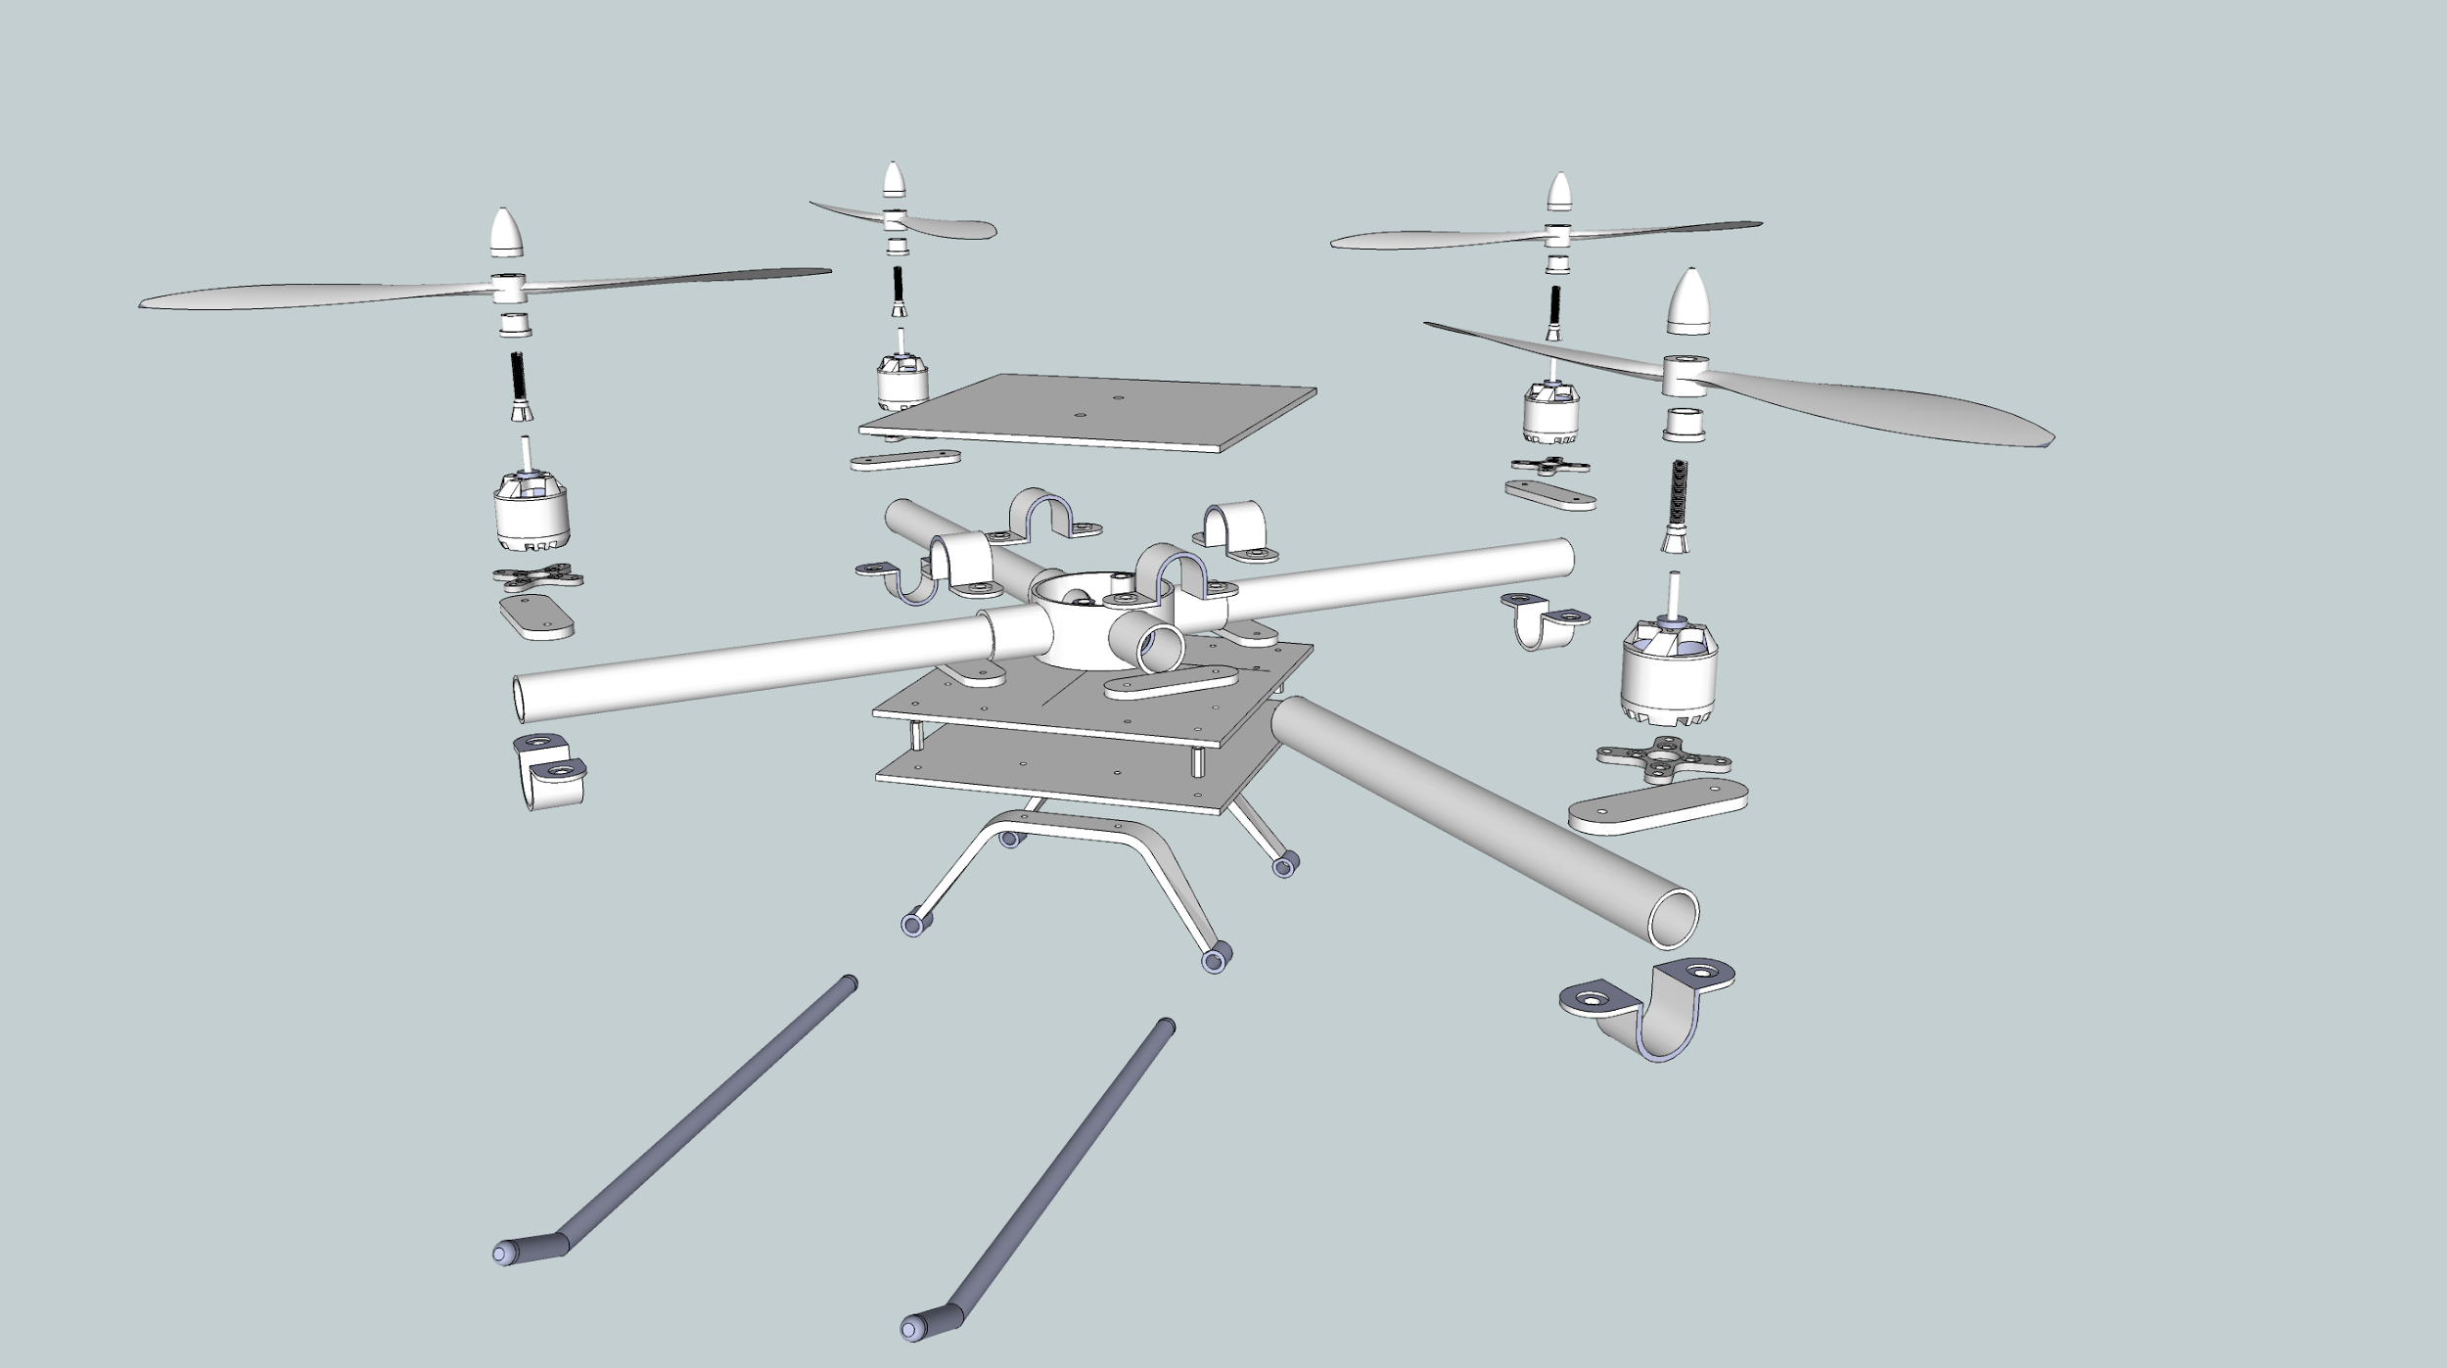

Slide 30
Directory Layout
Sketchbook Directory
/Main
/Main.ino
/libraries
/Library1
/Library1.c (or Library.cpp)
/Library1.h
/Keywords.txt (optional used only in arduino IDE)
/Readme
/Utility (Note: Any helper functions)
/File1.c (or File1.cpp)
/File1.h
/File2.c (or File2.cpp)
/File2.h
/Examples
/Example.ino

Slide 32
Library Source (.cpp)
Any declaration of variable or constant must prefix with data type and postfix units
Constants must be defined in capitals
Function must be defined as follows setVoltage(), getCurrent()
Variables must be defined as follows sensor_voltage_v, sensor_current_mA

Slide 33
User Manual
Calibration of the MPU_6050
Calibration instructions
Flash the MPU6050_ Calibration code to the arduino
Connect to the the arduino and view on the screen serial message
follow on screen instructions
Once the calibration is complete update the offset values in the sensor.h file
Example Result from calibration program
Sensor readings with offsets: -1 5 16378 1 0 0
Your offsets: -5193 2336 811 89 56 38

Slide 34
User Manual
PID Tuning
SW:
#define TUNE set to 1
HW:
Remove jumper
Connect Pot

Slide 35
User Manual
* To Calibrate motors
Flip aux1 to on position
* 1. Connect USB cable (PC - Arduino)
* 2. Ensure Transmiter and and Rx are connected
* 3. Set throttle stick to max
* 4. Toggle AUX to ON
* 5. Restart the Arduino
* 6. Connect the battery
You will here a musical tone followed by 2 beeps
After 2 beeps lower stick to min position
Will then here beeps
Cal complete

Slide 36
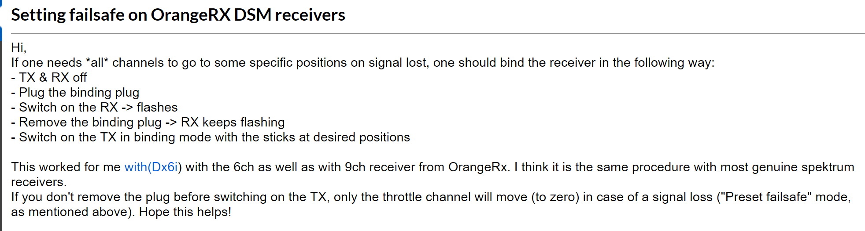

Slide 37
Release Notes
Ver3

Slide 38
NOTES

Slide 39
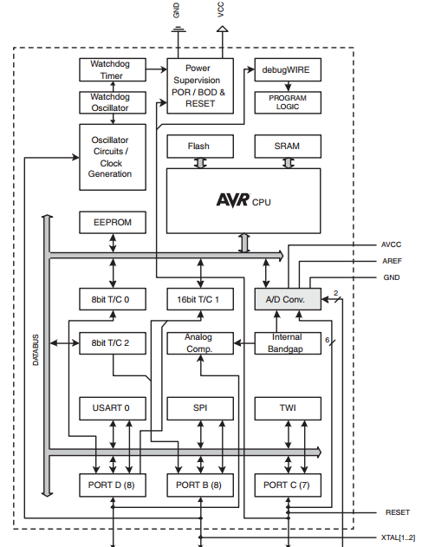
Atmega 328p Hardware

Slide 40
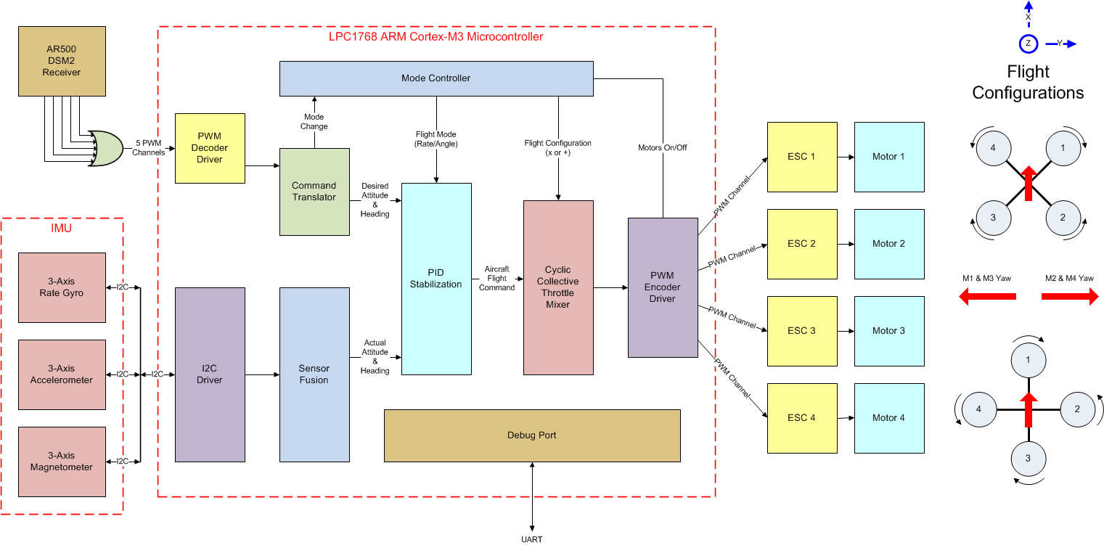

Slide 41
Schedulers
Time triggered
Pre-emptive/time-sliced scheduler: runs a task for say 1 ms then pauses and runs another for 1 ms. This will make it appear to be running multiple tasks in parallel. Problem may occur if task share a resource
Co-operative scheduling - while a task is running it will not allow interrupts to interrupt it

Slide 42
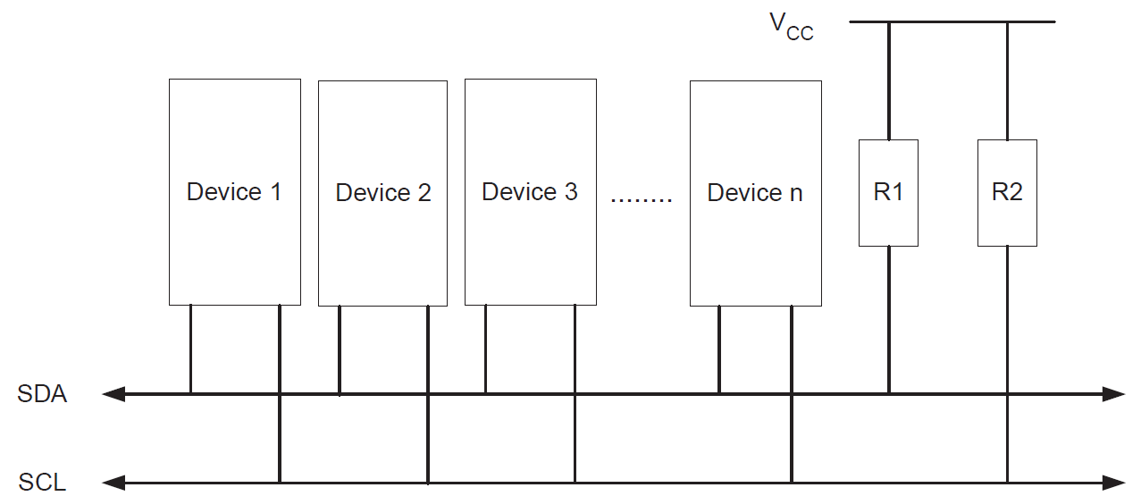
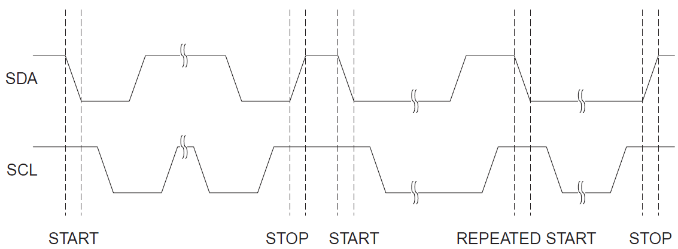
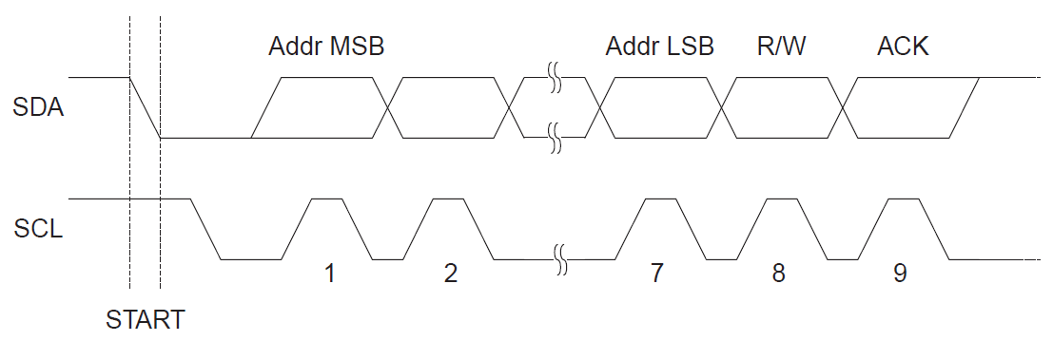
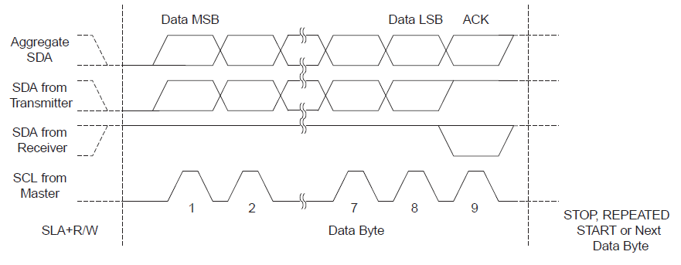
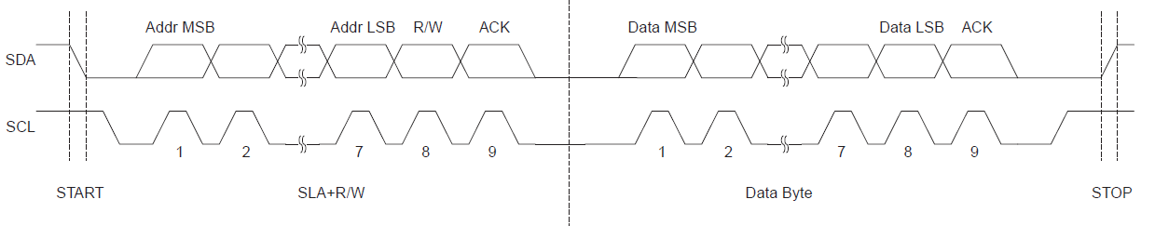
Link
Link2
I2c Driver
2-wire Serial Interface (TWI)
SCL - Serial Clock
SDA - Serial Data
START
STOP
READ/WRITE
ADDRESS

Slide 43
Arduino Wire Library
#include <math.h>
#include <stdlib.h>
#include <inttypes.h>
#include <avr/io.h>
#include <avr/interrupt.h>
wire.begin()
twi.init(),
digitalWrite(SDA, 1), digitalWrite(SCL,1);, Initialize prescaler
// initialize twi prescaler and bit rate
cbi(TWSR, TWPS0);
cbi(TWSR, TWPS1);
TWBR = ((F_CPU / TWI_FREQ) - 16) / 2;
Where: F_CPU = 16000000L
TWI_FREQ = 100000L
wire.beginTransmission(address)
No calls to TWI just variables.Set the address of the slave as variable
wire.write(value)
No Calls to TWI. Updates the buffer variable with the new buffer element
wire.read()
No Calls to TWI. Read from the buffer variable
wire.endTransmission()
twi_writeTo(address, data, length, wait, send stop)
Note: This is a blocking function

Slide 44
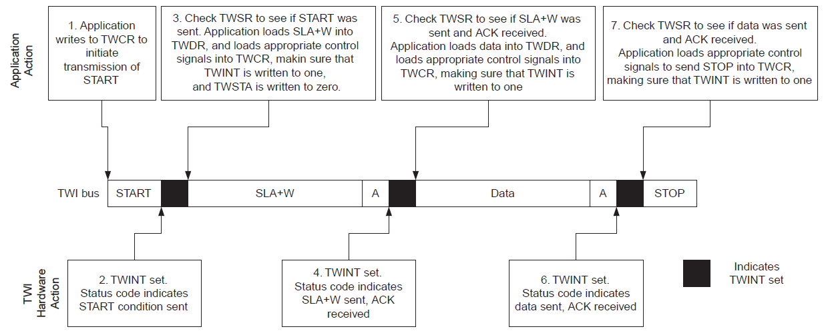
8 bits sequence
8 bits sequence
8 bits sequence
S | 6 | 5 | 4 | 3 | 2 | 1 | 0 | R/W | A | 7 | 6 | 5 | 4 | 3 | 2 | 1 | 0 | A | 7 | 6 | 5 | 4 | 3 | 2 | 1 | 0 | A | S
Device (Slave) Address
SLA+ R/W
Internal Register Address
Data
Start
(N)Ack.
Stop

Slide 45
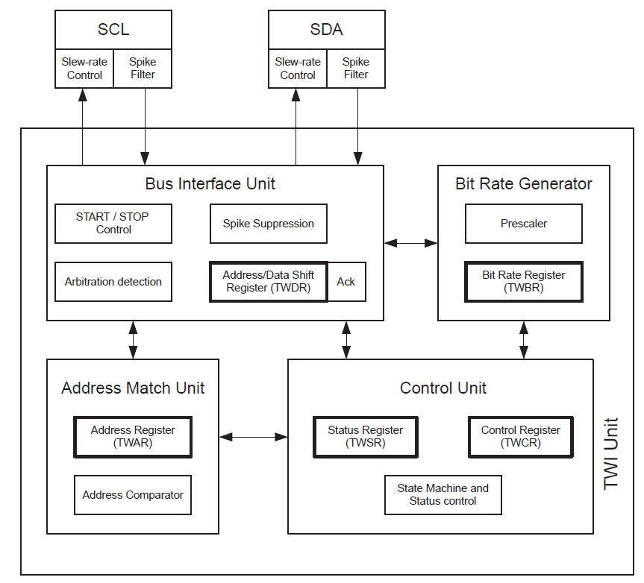
Registers
SCL Defined by:
TWI Bit Rate Register (TWBR)
TWI Status Register (TWSR)
Note: CPU clock frequency in the Slave must be at least 16 times higher than the SCL frequency
Data and Address Shift Register (TWDR)
Note: (N)ACK Register is not directly accessible by the application software
TWI Control Register (TWCR).
Note: When in Transmitter mode, the value of the received (N)ACK bit can be determined by the value in the TWSR.
The Address Match unit checks if received address bytes match the seven-bit address in the TWI Address Register (TWAR).
TWI Interrupt Flag (TWINT)
TWI Interrupt Enable (TWIE) bit in TWCR
twi .h where the staus are defined
C:\Program Files (x86)\Arduino\hardware\tools\avr\avr\include\util
#include <compat/twi.h>
Link

Slide 46
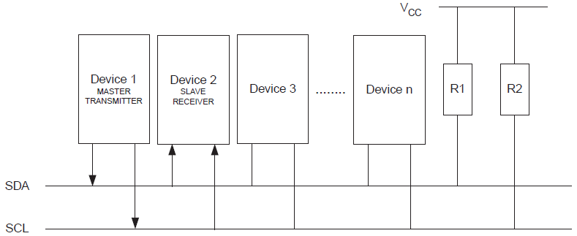
Master Writter

Slide 47
Controller
This module is the main controller to the application it is responsible for scheduling tasks.
The controller will also handle timing and be linked to Timer/Counter 1 16 bit
When TC1 Overflow it will generate an interrupt. Rate = 1MHz 1us
Needs to be 1MHz to enable accurate measurement of Read PWM signals
The ISR (Interrupt Service Routine) will increment a counter. - This counter will increment a bunch of counters. Count will increment every 10us
Need to have a task offset from the start to prevent task clash
Controller ISR
//Increment global variable task counters
//Called every 1us 1MHz
task_a_count_G++
task_b_count_G++
task_c_count_G++
task_d_count_G++
Controller
Free Running
Controller
TASK_A_TICKS = 10 //[10us]
TASK_A_OFFSET = 0
TASK_B_TICKS = 50000 //[50,000us]
TASK_B_OFFSET = 1
TASK_C_TICKS = 500 //[500us]
TASK_C_OFFSET = 2
TASK_D_TICKS= 2000 //[2,000us]
TASK_D_OFFSET = 3
initTasks(){
task_a_count_G = TASK_A_OFFSET;
task_b_count_G = TASK_B_OFFSET;
task_c_count_G = TASK_C_OFFSET;
task_d_count_G = TASK_D_OFFSET;
}
// Will be true when task duration has elapsed
If (task_a_count_G >= task_a_ticks + TASK_A_OFFSET){
task_a_counter = TASK_A_OFFSET; //Rest the counter
[TASK CODE]
}
if(task_b_count_G >= task_b_ticks + TASK_B_OFFSET){
Task_b_counter = TASK_B_OFFSET;
[TASK CODE]
}
Interrupt
ISR
Controller
Free Running
Set flags, push entries on a private stack or make entries in an array, etc. inside the interrupt handler to log the event, then have the main loop process the events as it can.

Slide 48
The Radio Module is responsible for calculating the pulse width of the incoming PWM signal.
When a PCINT is generated the current clock tick and a flag are sent to the radio module
The Radio module takes this flag and ticks and stores locally to module (local variable)
Will wait for rising and falling edge - perform calculation to get pulse width
Update global variable with pulse width
This global variable will hold the latest value allowing other modules to read only this value (Global Variable will be wrapped in API: readThro, readELEV etc)
Radio (100 KHz)
Sensors (100Hz)
Sensors are read at 100Hz as this is the speed new data is available from the IMU
Instead of a fixed time period perhaps the IMU can send a PCINT to the arduino when it is ready for reading
The read value will be shared in a global variable for other modules to read only
PID Control (200Hz)
PID loops can only happen as fast as there is new data available. So is at the mercy of the IMU. 200Hz (5ms) loop rates.
RISK: is this enough time to execute 6 PID loops. 62.5ns = 1 machine cycle => 5ms = 80,000 machine cycles
Rate controller
Stabilization
Cyclic Collective Throttle Mixer (200Hz)
Runs at the same rate as the PID control as the output from the PID feeds this module.
Module is responsible for reading the output from the PID and mixing it with the throttle to control all 4 motors
Needs to consider the mode “X” or “+”
Debug (100Hz)
Leveraging the arduino serial library just for debug to enable text to be output
Will have a buffer that will be worked through
Digital Write (20hz)
Useful for debugging to ensure section of code are running up to speed with scope
Can also be used with LEDs connected
Watchdog (1MHz)
The watchdog needs to be fed every 15ms
If not it will reboot
Can be reset after every cycle of the main controller. 1MHZ
Main Controller(1MHz)
The main controller is responsible for scheduling tasks and feeding the watchdog.
Main controller is driven from Timer/Counter 1 Overflow.

